Slide 1
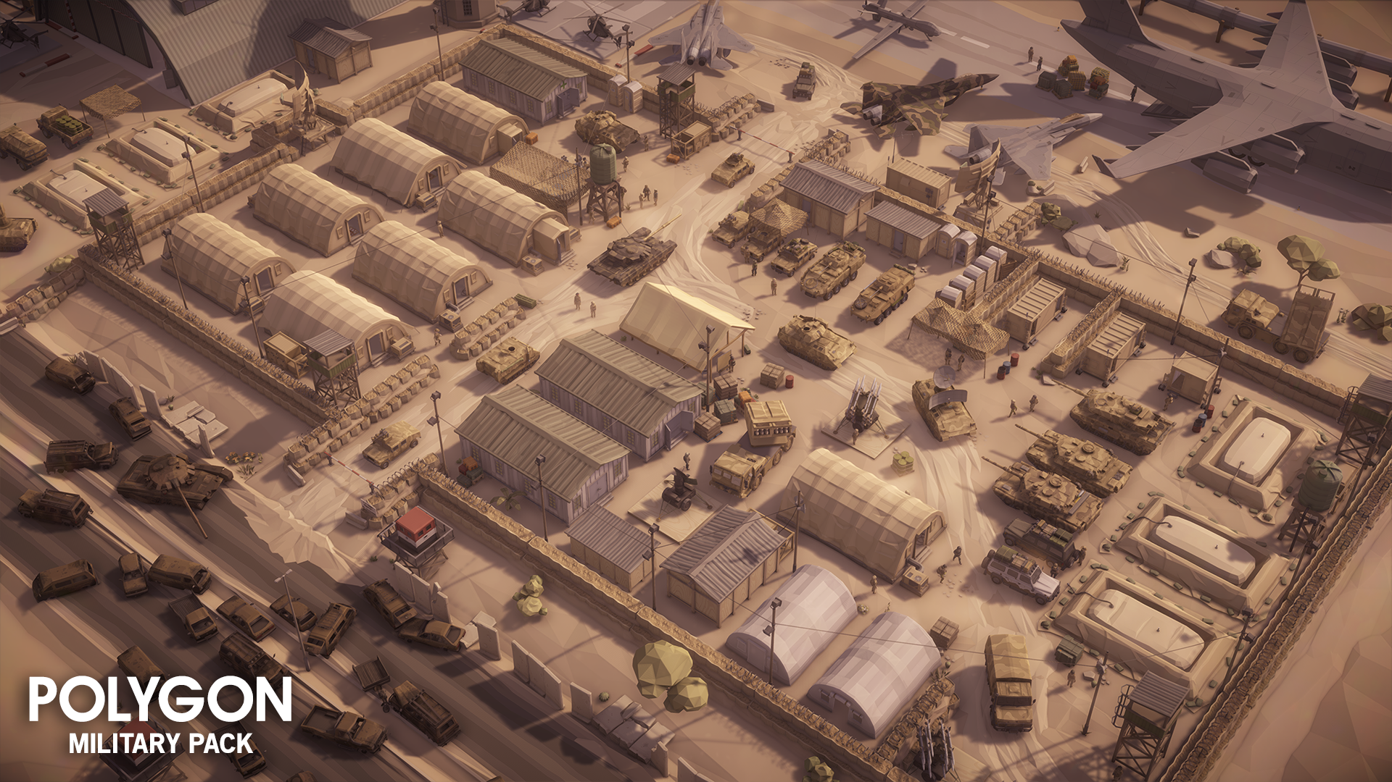
Minor Skilled Evaluation presentation 1
Nils Meijer - 466301

Slide 2
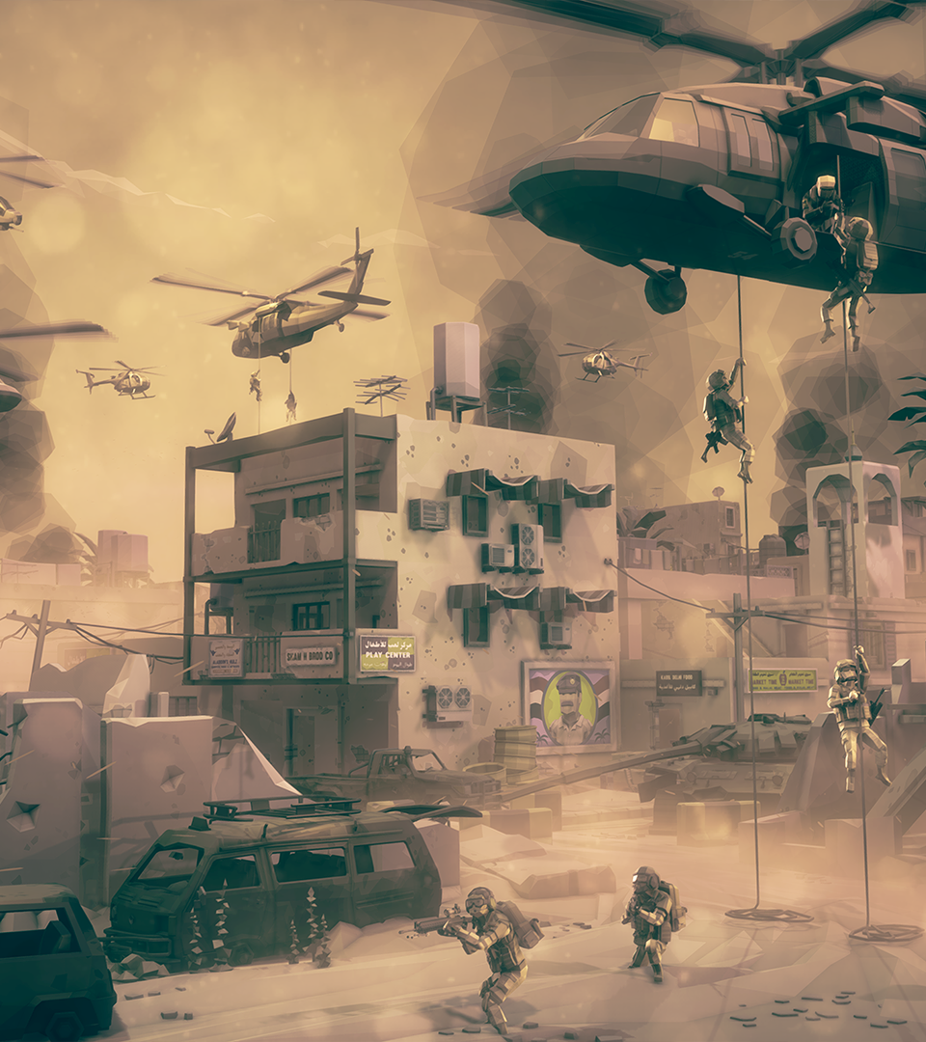
What were my ideas?
Synty asset pack
Gun range
Tank simulator (final choice)
Action game
AI behaviour
Potential future jobs
AI programmer
Gameplay programmer
Tool programmer

Slide 3
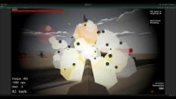
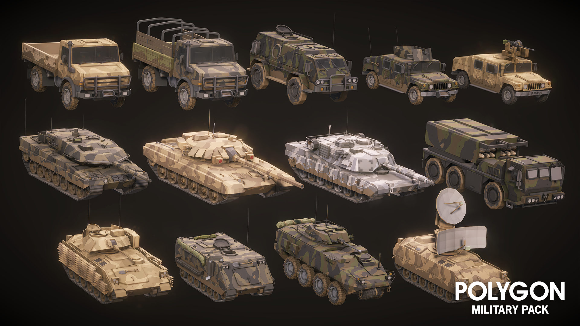
What did I work on?
Week 1
Brainstorming
Research (documents here!)
Started programming Tank Controller components
Week 2
Movement component
Custom editor
Camera controller
Shooting component
Week 3
Shooting component
Damage registration system
Week 4(.5)
Research
Reworked movement component (gear shifting)

Slide 4
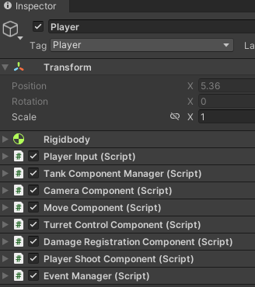
How did it work out?
Researched several tank-related games
Gunner Heat PC, War thunder, World of Tanks
Implementing features by breaking down into goals > subgoals
Example: Tank Controller
Move component
Subgoals:
Custom editor window
Tank tracks (wheel colliders)
Gear shifting system
Turret control component
Subgoals:
Turret rotation
Barrel/cannon rotation
Camera Component
Subgoals:
ADS
1ST person
3rd person

Slide 5
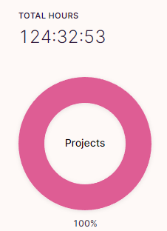
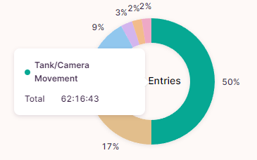
Planning
Toggl hours tracking
Agile workflow - feature-driven development (previous slide)
Set goals to achieve and skills to learn

Slide 6
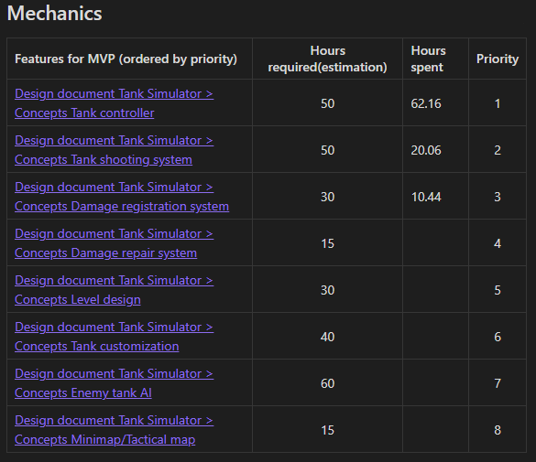
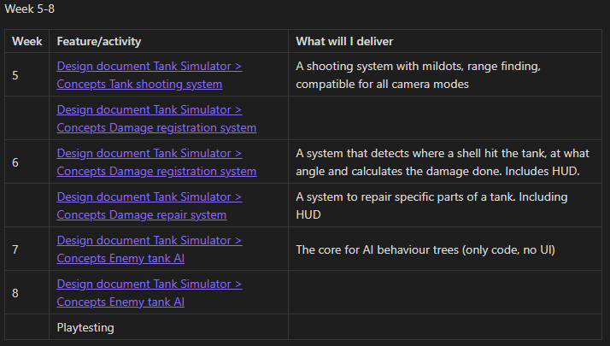
Planning
Planning specifies:
Priority
Per week
Feature
What will I deliver
Planning 4/5 weeks ahead at a time
Planning until next evaluation ->

Slide 7
Quality Assurance
Former colleague/lead developer Total Reality
Feedback gathered, but not enough time to apply all of it. Involved some feedback that takes some time to implement.
Questions/answers on next slide
Emailed several studios developing tank simulators
No response yet (and not expecting it)
Better off messaging individual people on Twitter
For the rest of the minor:
Preferably multiple meetings with Quality Assurer(s?)
Playtests with target group (

Slide 8
Quality Assurance
Is it obvious for every class/method what it is supposed to be doing
Can/should the code be broken down further into more classes/methods?
Are there any obvious performance issues?
Are there any logic issues?
How can the communication with the HUD be improved?
How consistent are the naming conventions?
Other suggestions
Answers here

Slide 9
What I can do better – self reflection
Update/increase hour estimations if:
Things take longer than expected
Features are implemented differently than expected
Be mindful of getting side-tracked (working on other features at the same time)
More detailed hour registrations - know exactly what I did on a day

Slide 10
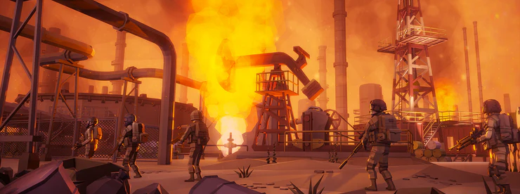
Questions
Glenn Comis
“Call me if you need a job, you would be of great use!”

